Slide 1
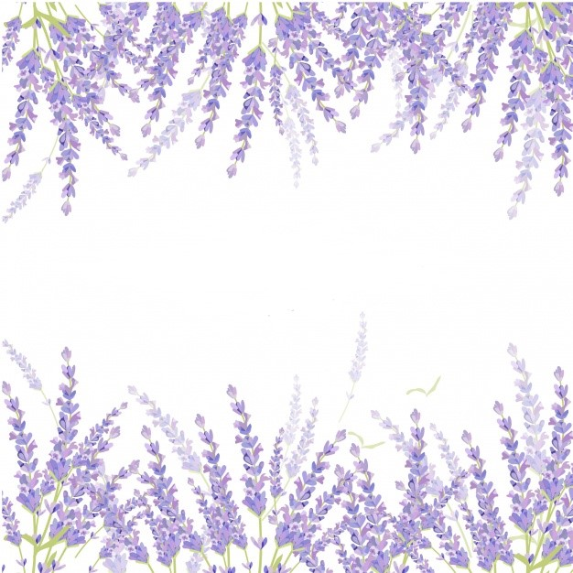
Yordanov Family Farm
100% Pure Essential Oils and Crops

Slide 2
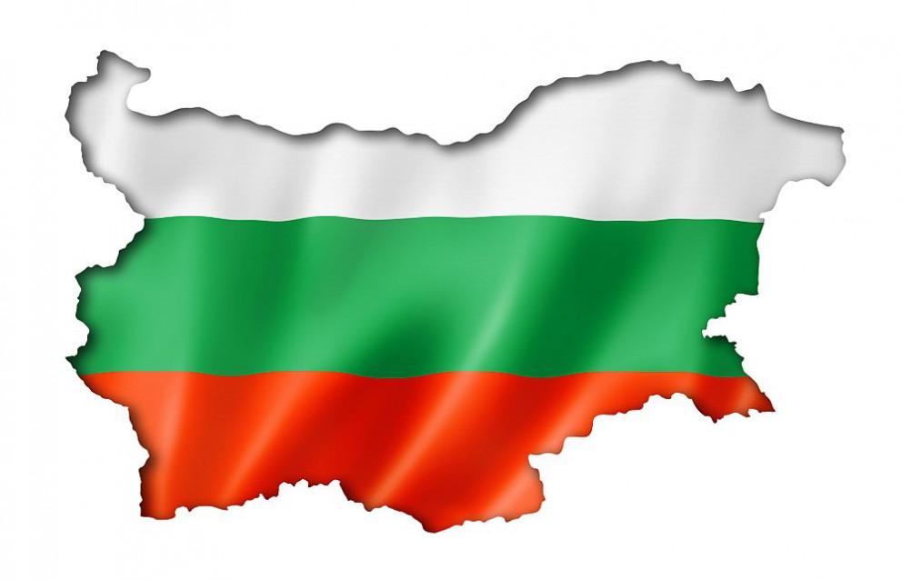
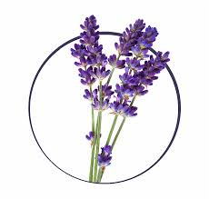
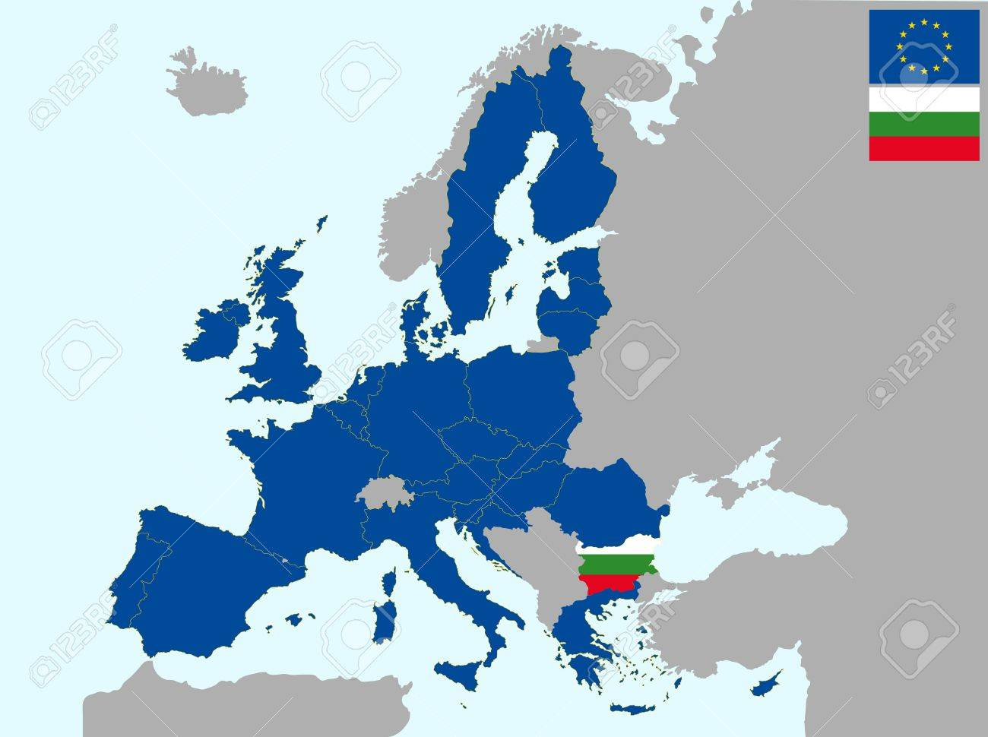
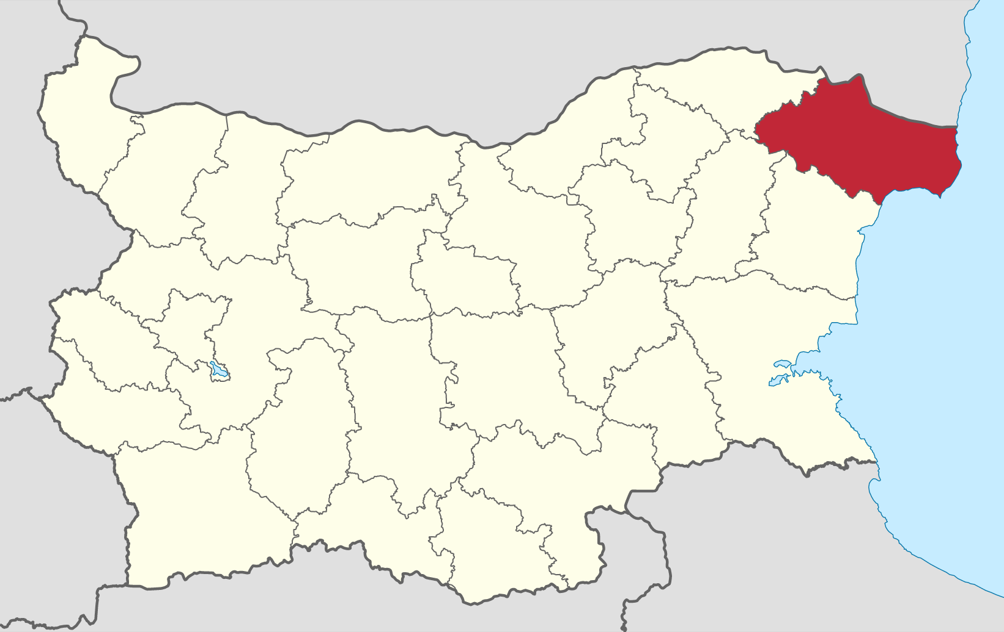
Where are we located ?
Yordanov Family Farm
Malina, Dobrich, Bulgaria, Europe

Slide 3
Who are we ?
Yordanov Family Farm
Yordanov family has a long experience in agriculture, cultivation of agricultural crops, industrial crops and livestock breeding
Several generations grew up loving the land and feeling satisfied with the joy that creation brings
Our experience and the will to overcome various challenges has been the driving force which makes us confident to continue

Slide 4
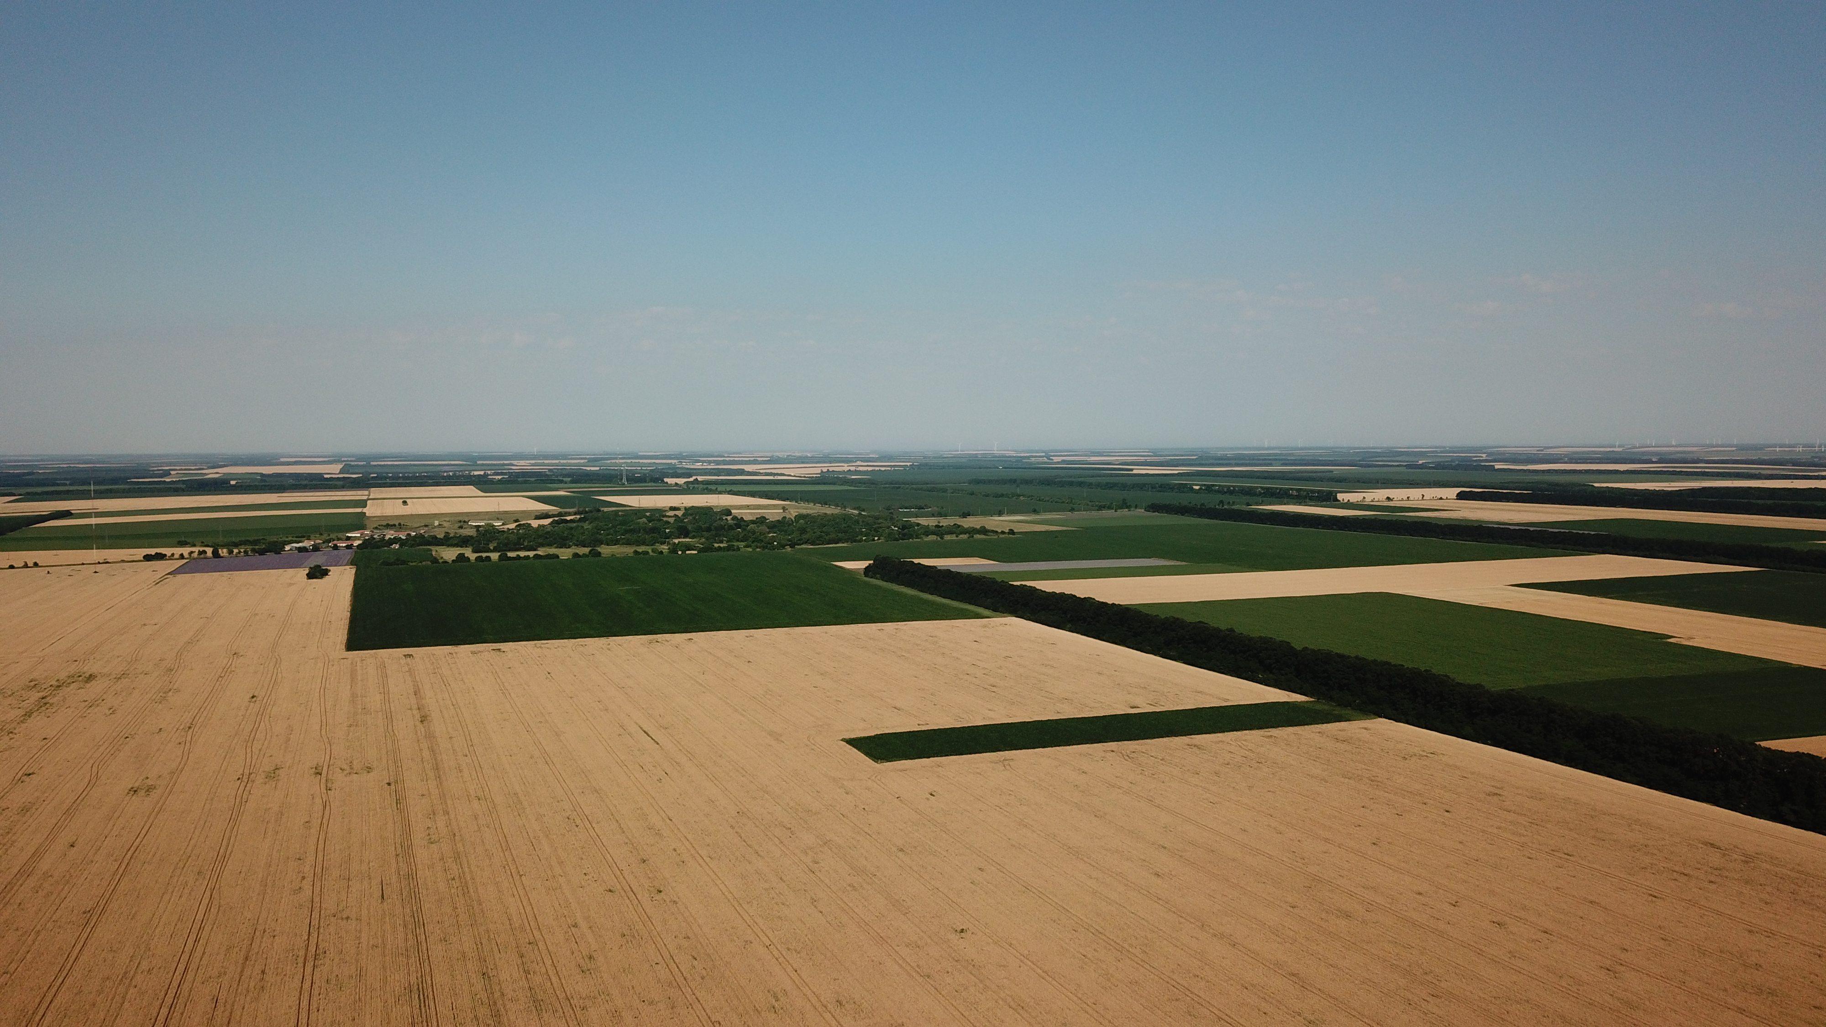
Yordanov Family Farm
Our core business is growing conventional cereal and essential oil crops
We strive to continue developing and be part of the modern agricultural trends
In 2009, we have created the first lavender plantations in our farm. It took us only several years to plant 250 decares of lavender

Slide 5
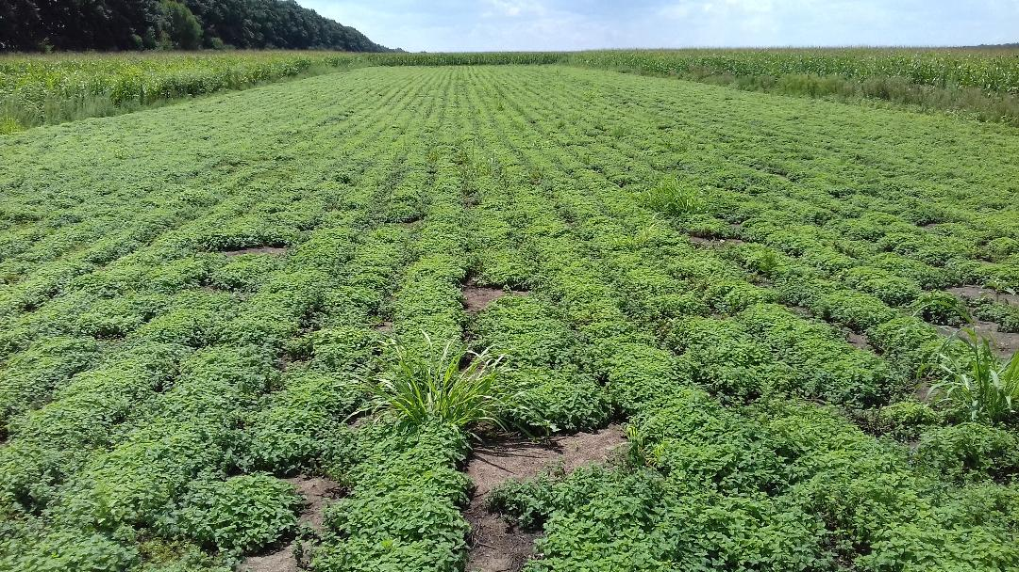
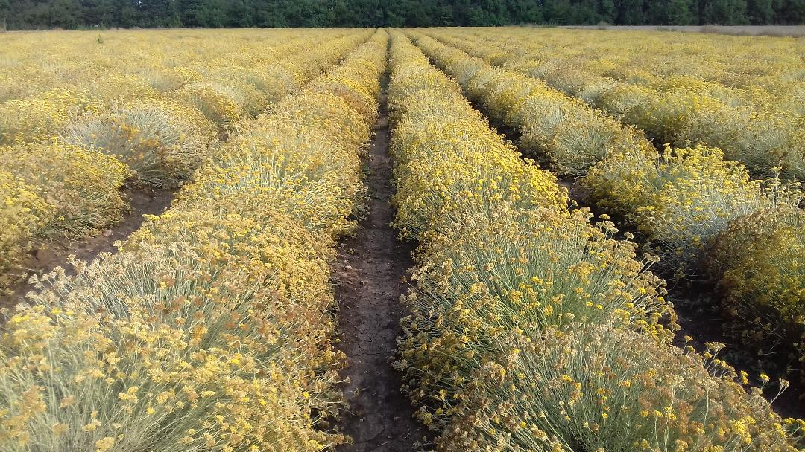
Yordanov Family Farm
The entire process – from planting the seeds to cultivating and flower gathering meets the modern standards in this sector
We continue investing in new cultures. Four years ago, we also made plantations with Helichrysum (Helichrysum italicum or Immortelle) and Melissa (Lemon Balm)
Melissa
Helichrysum

Slide 6
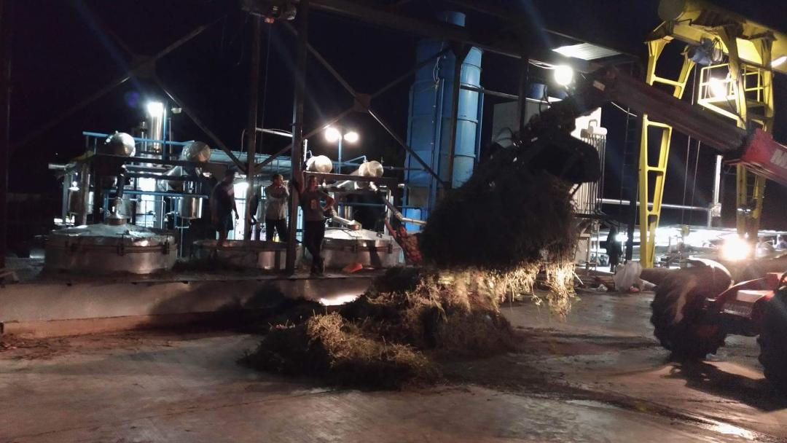
We have annual growth of essential oil extraction. Lavender oil production is more than 1400 kg per year
The entire harvest is processed until essential oil of high quality is produced through steam distillation in new automated distillery plants which meet the modern quality control criteria for each stage of the process
The essential oil is stored in certified containers
Yordanov Family Farm

Slide 7
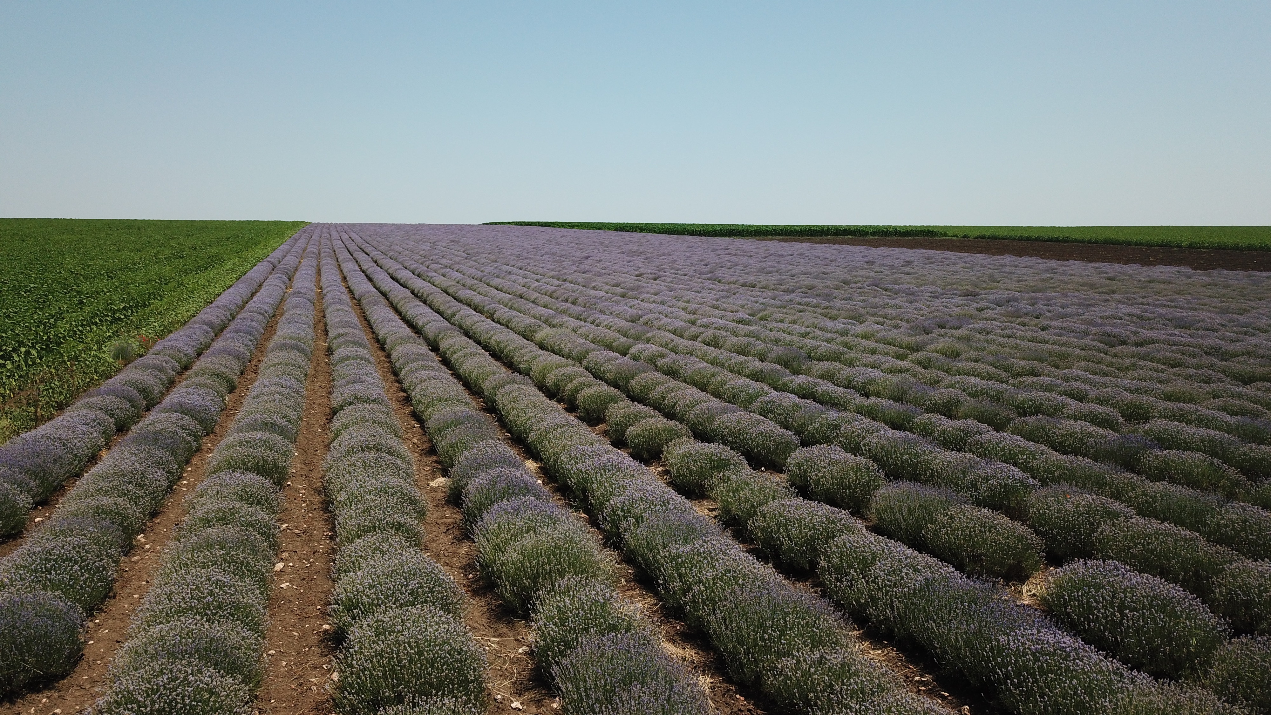
Yordanov Family Farm
The production quality is tested in specialized test laboratories which meet the European standards
We sell the entire production of lavender oil on the international market, mainly in the European Union (France, Austria, Germany, etc)

