Slide 1
“Preparing for International Business based on the Characteristics and Preferences of Japanese Customers ”
Hideo Horiguchi
JICA Expert for TDAP

Slide 2
Photo: Cabinet Office Cool Japan Strategy

Slide 3
1. JAPAN/EAST ASIA/ASEAN
EU
446million＋UK6.6million
EAST ASIA
-CHINA
1.39billion
-S.KOREA
51.27million
UNICLO -China:6Shops
-S.Korea:3Shops
MUJI -China:256Shops
-S.Korea34Shops
UNICLO:18+UK5 Shops
MUJI:31+UK11Shops
JAPAN
126.02million
USA
327. 75million
⓵Visitors Arrival 2019(Jan.-Dec.)
From China: 9.6million
(Total 31.9million)
⓶Import of Clothing 2018
(Jan.-Dec. Million yen)
China Share:59.9%
UNICLO:13Shops
MUJI:17Shops
⓵3.8million
⓶27.5%
UNICLO:5 Shops
MUJI:47 Shops
ASEAN
650million
Source: MOFA, JNTO, JTIA, UNICLO HP, MUJI HP

Slide 4
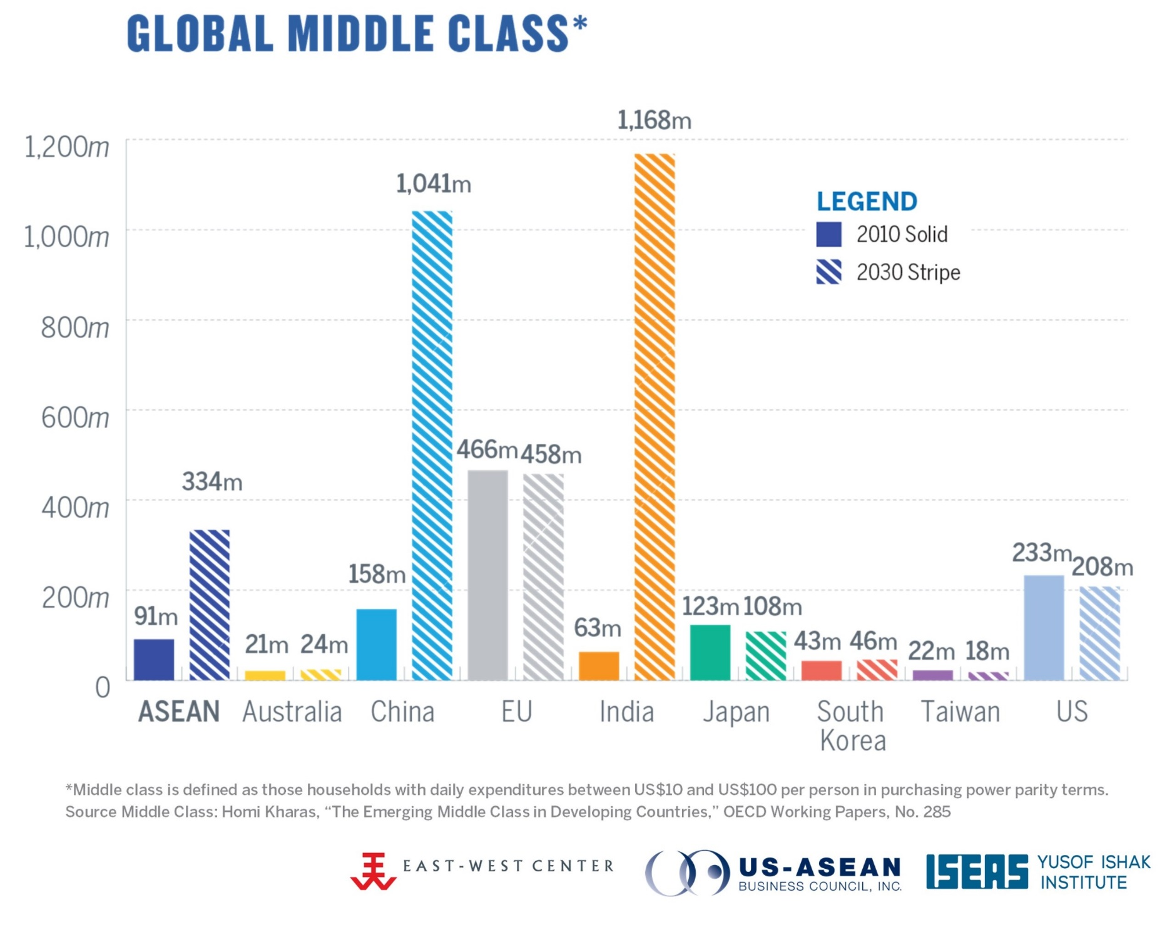
2. Emerging Market
Source: US ASEAN BUSINESS COUNCIL,INC
Growth Projections https://www.usasean.org/why-asean/growth

Slide 5
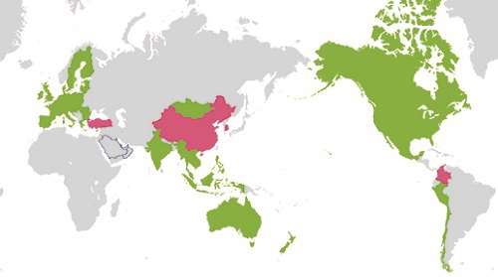
3. Japan EPA Network December 27, 2019 MOFA
EPA/FTA in Japan
●In Force or Signed▶18 Singapore, Mexico, Malaysia, Chile, Thailand, Indonesia, Brunei, ASEAN, Philippines, Switzerland, Viet Nam, India, Peru, Australia, Mongolia, TPP12 (signed), TPP11, EU
●Under Negotiation▶4 RCEP, Turkey, Colombia, Japan-China-ROK
◯Others (Negotations suspended) GCC, Korea, Canada
Source: Ministry of Foreign Affairs of Japan

Slide 6
4. Pakistan FTA Network Dec.2019
Pakistan China FTA:2007
Second Phase:Dec.2019
GSP+ (2014～)
Preferential Trade
Agreement (2006)
GSP
EU
China
Japan
Iran
GSP
Trade&Investment Framework Agreement (2003)
Turkey
(Under Negotiation)
Pakistan
USA
Pak Afghanistan Transit Trade Agreement
Mauritius
ASEAN
Preferential Trade Agreement (2007)
Pakistan Malaysia FTA&EIA (2008)
Pakistan Indonesia Preferential Trade Agreement (2013)
Pakistan Thailand FTA (Under Negotiation)
Sri Lanka
SAFTA (2006)
Pakistan Sri Lanka FTA (2005)
Source: Government of Pakistan Ministry of Commerce, WTO

Slide 7
5. Japan Textile Industry 1960& Current
Items
Share(%)
Japan’s Export (1960)
Textile Industry (2017)
*Establishments: 5.7％
*Employees: 2.8%
*Import Penetration ratio (2018) 97.7% of Clothing
Source: Ministry of Economy.Trade & Industry information Jan.2020
(繊維産業の現状と経済産業省の取組)
Commodities | Export Share
Textile | 30.2%
Machinery (Vehicle) | 25.3% (2.6% )
Metal | 13.8%
Chemical | 4.2％
Others | 26.5%
OEM (Original Equipment Manufacturer)
Material
Fabrics
Production site
Re-Export
Donor Contents GSP

Slide 8
Reference 1: Law
●実行関税率表（2020年1月1日）
Japan's Tariff Schedule as of January 1 2020
https://www.customs.go.jp/english/tariff/2020_1/index.htm
●家庭用品品質表示法
Household Goods Quality Labeling Act
http://www.japaneselawtranslation.go.jp/law/detail/?id=2217&vm=04&re=01&new=1
●有害物質を含有する家庭用品の規制に関する法律
Act on Control of Household Products Containing Harmful Substances
http://www.japaneselawtranslation.go.jp/law/detail/?id=1949&vm=04&re=01&new=1

Slide 9
Reference 2: GSP Origin Rule
I. Origin Criteria
II. Consignment Criteria
III. Procedural Provisions
Wholly obtained or produced goods
Goods satisfied substantial transformation criterion
Origin criteria
Specific manufacturing or processing operation criterion
Change in tariff classification criterion
Value-added criterion
Source: JAPAN CUSTOMS

Slide 10
Reference 3: Specific manufacturing or processing operation criterion
(source:List of Conditions to Qualify as an Originating Good under Japanese GSP (Product Specific Rules) https://www.mofa.go.jp/files/000077857.pdf)
Chapter 61 Articles of apparel and clothing accessories, knitted or crocheted Manufactured from woven fabrics, felt, nonwovens, knitted or crocheted fabrics or lace of Chapter 50 to 56 or 58 to 60
ex. Chapter 62 Articles of apparel and clothing accessories, not knitted or crocheted, excluding products of heading 62.13 to 62.17 Manufactured from woven fabrics, felt, nonwovens, knitted or crocheted fabrics or lace of Chapter 50 to 56 or 58 to 60
62.13 Handkerchiefs Manufactured from chemical products, from products of heading 47.01 to 47.06, or 50.01, or from natural textile fibres (excluding raw silk), man-made staple fibres or textile fibre waste
62.14 Shawls, scarves, mufflers, mantillas, veils and the like Manufactured from chemical products, from products of heading 47.01 to 47.06, or 50.01, or from natural textile fibres (excluding raw silk), man-made staple fibres or textile fibre waste
62.15 Ties, bow ties and cravats Manufactured from textile yarn 62.16 Gloves, mittens and mitts Manufactured from textile yarn 62.17 Other made up clothing accessories; parts of garments or of clothing accessories, other than those of heading 62.12 Manufactured from textile yarn
62.16 Gloves, mittens and mitts Manufactured from textile yarn 62.17 Other made up clothing accessories; parts of garments or of clothing accessories, other than those of heading 62.12 Manufactured from textile yarn
62.17 Other made up clothing accessories; parts of garments or of clothing accessories, other than those of heading 62.12 Manufactured from textile yarn

Slide 11
Reference 4: Certificate of Origin (GSP) FORM A Sample
1. Goods consigned from (Exporter’s business name, address, country) | Reference No GENERALISED SYSTEM OF PREFERENCES CERTIFICATE OF ORIGIN (Combined declaration and certificate) FORM A Issued in e.g. PAKISTAN (country) See Notes overleaf
2. Goods consigned to (Consignee’s name, address, country)
3. Means of transport and route (as far as known) | 4. For official use

Slide 12
NOTES (2013)
Countries which accept Form A for the purposes of the Generalized System of Preferences (GSP):
Australia* Belarus Canada Iceland Japan New Zealand** Norway Russian Federation Switzerland including Liechtenstein*** Turkey United States of America****
European Union: Austria Belgium Bulgaria Croatia Cyprus Czech Republic Denmark Estonia Finland France Germany Greece Hungary Ireland Italy Latvia Lithuania Luxembourg Malta
Netherlands Poland Portugal Romania Slovakia Slovenia Spain Sweden United Kingdom
8. Origin criterion (see Notes overleaf)
(3) Iceland, the European Union, Japan, Norway, Switzerland including Liechtenstein, and Turkey; enter the letter "W" in Box 8 followed by the Harmonized Commodity Description and coding system (Harmonized System) heading at the 4-digit level of the exported product (example "W" 96.18).

Slide 13
5. Item number | 6. Marks and numbers of packages | 7. Number and kind of packages, description of goods | 8. Origin criterion (see Notes overleaf） | 9. Gross weight or other quantity | 10. Number and date of invoices
 |  |  | “W”+ HS 4-digit e.g. “W”6214

